Slide 1

TEAM 30
Software
Engineering Project
May 2024
Effective integration of Generative AI into programming learning environments

Slide 2

TEAM 30
Introduction
We are Team 30 for the May 2024 software engineering project. Our team consists of 8 members: 2 working professionals, 3 dual-degree students, and 3 standalone students, with Anjali serving as our team leader.
Meet our team!
Anjali Panchal
Sahil Sandhu
Abdul Ahad Rauf
Sanket Metrewar
Aman Verma
Neon Thapa
Pratham Sharma
Leo Tom
21F2000411
21F1002317
21F3002590
21F3000961
21F1006376
21F1000706
21F1006197
21F1005835

Slide 3

TEAM 30
Problem
Statement
The rapid advancement of technology has revolutionized the educational landscape, opening up new opportunities for personalized learning and interactive content delivery. Integrating generative AI into our Seek portal can further transform this environment by enabling various AI-assisted tasks.
Example 1
Example 2
Example 3
Summary Generation
Sometimes the lectures are a bit too long and we have limited time to go through them.
Providing external resources
Finding relevant additional resources for some topics that are not easy to understand manually can be time-consuming.
Chat with custom prompt
Sometimes we have numerous questions about the topics being taught in lectures but lack the opportunity to get them answered in real time.

Slide 4

TEAM 30
Possible Advantages
Integrating generative AI into the Seek portal saves time, enhances learning efficiency, provides relevant information, accelerates data access, and offers high-quality resources for a comprehensive learning experience.
Example 1
Example 2
Example 3
Summary Generation
Saves time and effort in reviewing content.
Provides concise and relevant information.
Enhances learning efficiency.
Providing external resources
Saves students’ time by quickly providing relevant materials.
Ensures access to high-quality external resources.
Enhances learning with a broader perspective.
Chat with custom prompt
Instant clarification helps grasp concepts more effectively.
Keeps students attentive and actively involved.
Enhanced learning retention ensures better recall.

Slide 5
TEAM 30
Types of users
Category | Users | Remarks
Primary | Students, Faculty Members | Students are the primary beneficiaries, utilizing GenAI features for enhanced learning. Faculty members utilize insights and analytics derived from GenAI interactions to improve teaching and course material.
Secondary | Support Staff | Support staff act as facilitators, addressing technical issues, providing guidance on GenAI features, and ensuring smooth operation.
Tertiary | Administrators | Administrators have overarching control, managing user roles, ensuring data privacy, analyzing GenAI impact, and overseeing system-level functions.

Slide 6
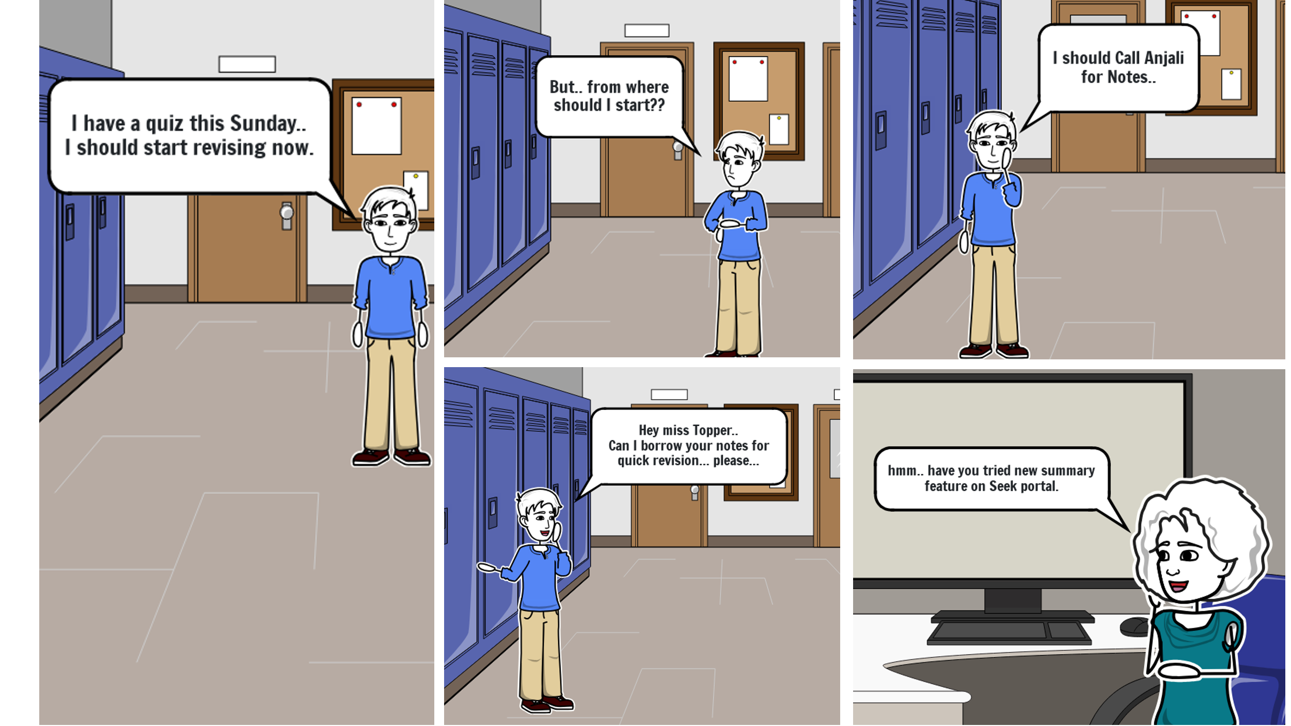
TEAM 30
Storyboard
It's quiz time, and as usual, Mr. Blue finds himself behind on his preparations. Unsure of where to begin, he decides to reach out to the class topper for advice. To his surprise, he learns about new features on the SEEK portal that he hadn't discovered before. These features promise to make his quiz preparation much easier. Excited by this revelation, Mr. Blue is now more confident about getting ready for the quiz, thanks to the helpful tips from the topper and the useful tools on the SEEK portal.

Slide 7
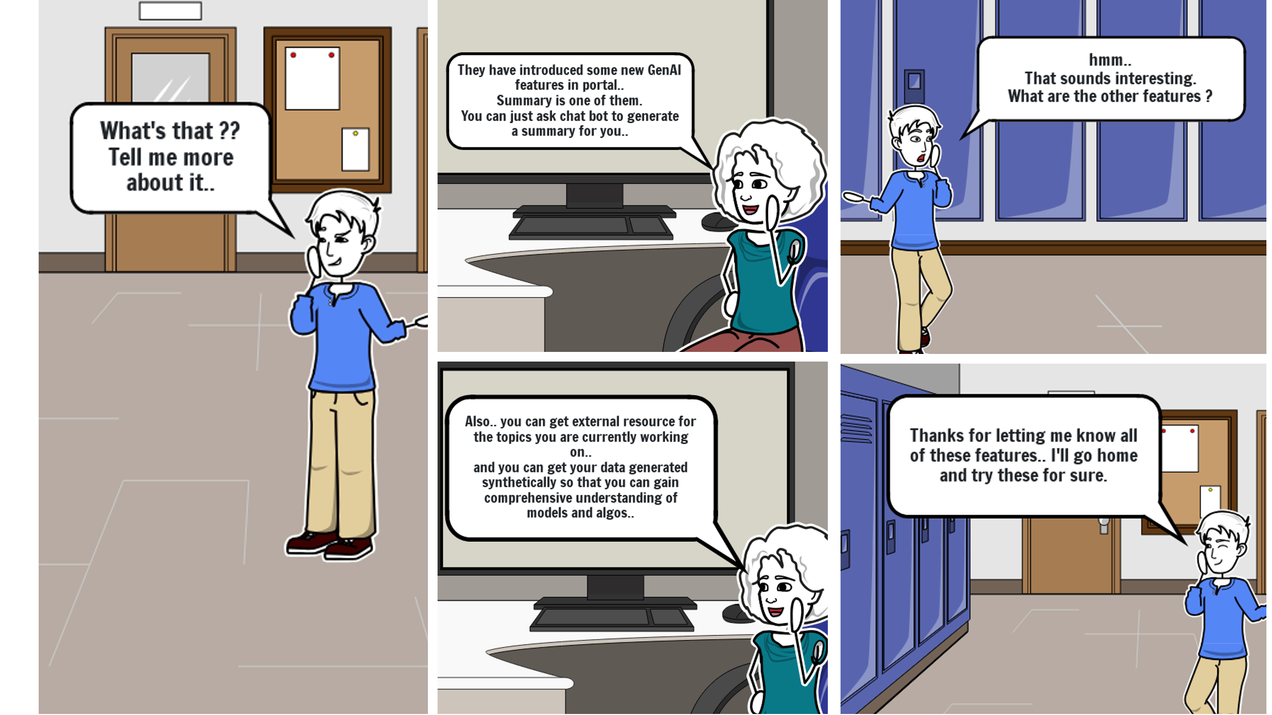
TEAM 30
Storyboard
To his surprise, he discovers that the SEEK portal has integrated Gen AI features. One of these is summary generation, allowing him to quickly generate summaries of lectures, saving valuable time on preparation. Another feature provides external resources for the topic he's studying, offering the extra help needed to fully grasp the concepts. The third and most impressive feature is custom chat prompts, which enable him to ask questions on any topic without needing to switch to a different chatbot website, keeping him focused within the study environment. When the topper shares all of this with him, he's excited to start using these powerful tools.

Slide 8
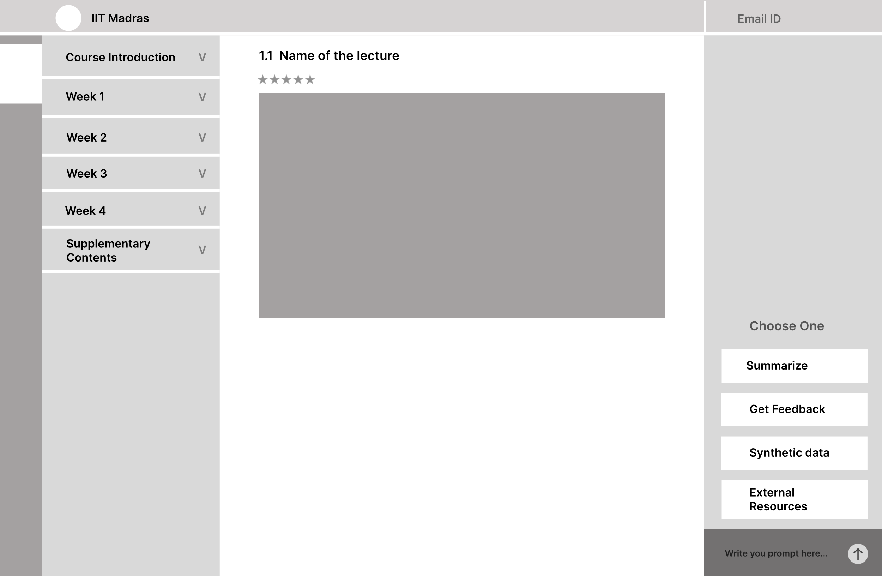
TEAM 30
Wireframe
The wireframe displays our chatbot integrated into the Seek portal, positioned at the far right side of the screen.
1. The Summarize button allows users to generate a summary of the opened lecture.
2. External Resources provide a list of internet-based resources related to the lecture.
3. Custom Chat enables users to ask questions in real-time, with the chatbot providing instant answers.
Choose one
Summarize

Slide 9
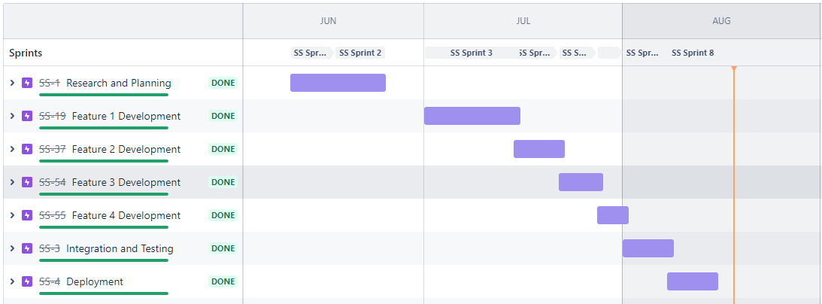
TEAM 30
Project Scheduling
Sprint 1: Brainstorm and Research.
Date: 10 Jun 2024 – 24 Jun 2024.
Sprint 2: integrating GenAI, backend, frontend development and testing.
Date: 1 Jul 2024 – 15 Jul 2024.
Sprint 3: integrating GenAI, backend,
frontend development and testing.
Date: 15 Jul 2024 – 22 Jul 2024.
Sprint 4: integrating GenAI, backend,
frontend development and testing.
Date: 22 Jul 2024 – 1 Aug 2024.
Sprint 5: Integrate GenAI models with
existing website
Date: 1 Aug 2024 – 8 Aug 2024.
Sprint 6: Documentation and
deployment.
Date: 8 Aug 2024 – 15 Aug 2024.

Slide 10
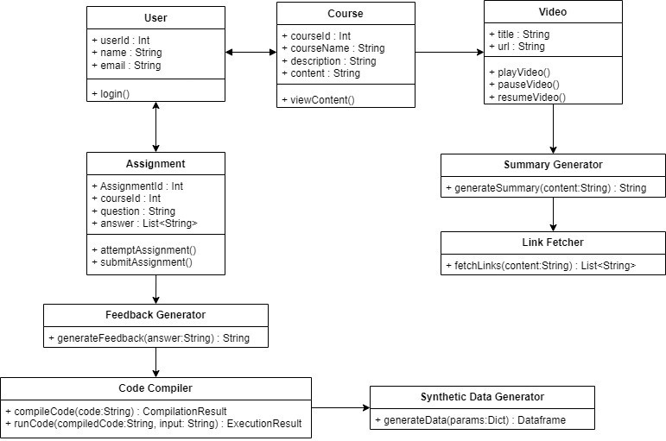
TEAM 30
Project Design
Backend components
To effectively integrate Generative AI into the SEEK our team discussed the necessary backend components that we will require for smooth functioning:
1. User Component
2. Course Component
3. Video Component
4. Feedback Component
5. Summary Component
6. LinkFetcher Component
7. SyntheticDataGenerator Component
8. Code Compiler Component
9. Chatbot Component
Frontend Components
The frontend of the Seek Portal with integrated GenAI features consists of a user interface designed to enhance the learning experience. Here's an overview of the key components:
1. Main Content Screen with Chatbot Sidebar:
2. Summarize Screen:
3. External Resources Screen:

Slide 11
TEAM 30
Tools & Technologies Used
FRONTEND
BACKEND
Framework/Library:
vue: ^3.2.13
vue-router: ^4.0.3
Styling:
@fortawesome/fontawesome-free: ^6.6.0
Utility:
axios: ^1.7.4
core-js: ^3.8.3
Development Tools:
@babel/core: ^7.12.16
@babel/eslint-parser: ^7.12.16
@vue/cli-plugin-babel: ~5.0.0
@vue/cli-plugin-eslint: ~5.0.0
@vue/cli-plugin-router: ~5.0.0
@vue/cli-service: ~5.0.0
eslint: ^7.32.0
eslint-plugin-vue: ^8.0.3
Frameworks:
Flask: 3.0.0
Flask-RESTful: 0.3.10
Flask-SQLAlchemy:3.1.1
Database:
SQLAlchemy: 2.0.25
Flask-Migrate: 4.0.5
alembic: 1.13.1
Task Queue:
celery: 5.3.6
kombu: 5.3.5
redis: 5.0.1
billiard: 4.2.0
vine: 5.1.0
HTTP Libraries:
httpcore: 1.0.5
httplib2: 0.22.0
httpx: 0.27.0
Utility:
amqp: 5.2.0
anyio: 4.4.0
aniso8601: 9.0.1
blinker: 1.7.0
cachelib: 0.9.0
certifi: 2024.7.4
checksumdir: 1.2.0
click: 8.1.7
click-didyoumean: 0.3.0
click-plugins: 1.1.1
click-repl: 0.3.0
colorama: 0.4.6
Flask-Caching: 2.1.0
Flask-Login: 0.6.3
greenlet: 3.0.3
h11: 0.14.0
idna: 3.7
itsdangerous: 2.1.2
Jinja2: 3.1.3
Mako: 1.3.0
MarkupSafe: 2.1.3
prompt-toolkit: 3.0.43
pyparsing: 3.1.1
python-dateutil: 2.8.2
pytz: 2023.3.post1
setuptools: 69.0.3
six: 1.16.0
sniffio: 1.3.1
tzdata: 2023.4
Werkzeug: 3.0.1
wcwidth: 0.2.13

Slide 12
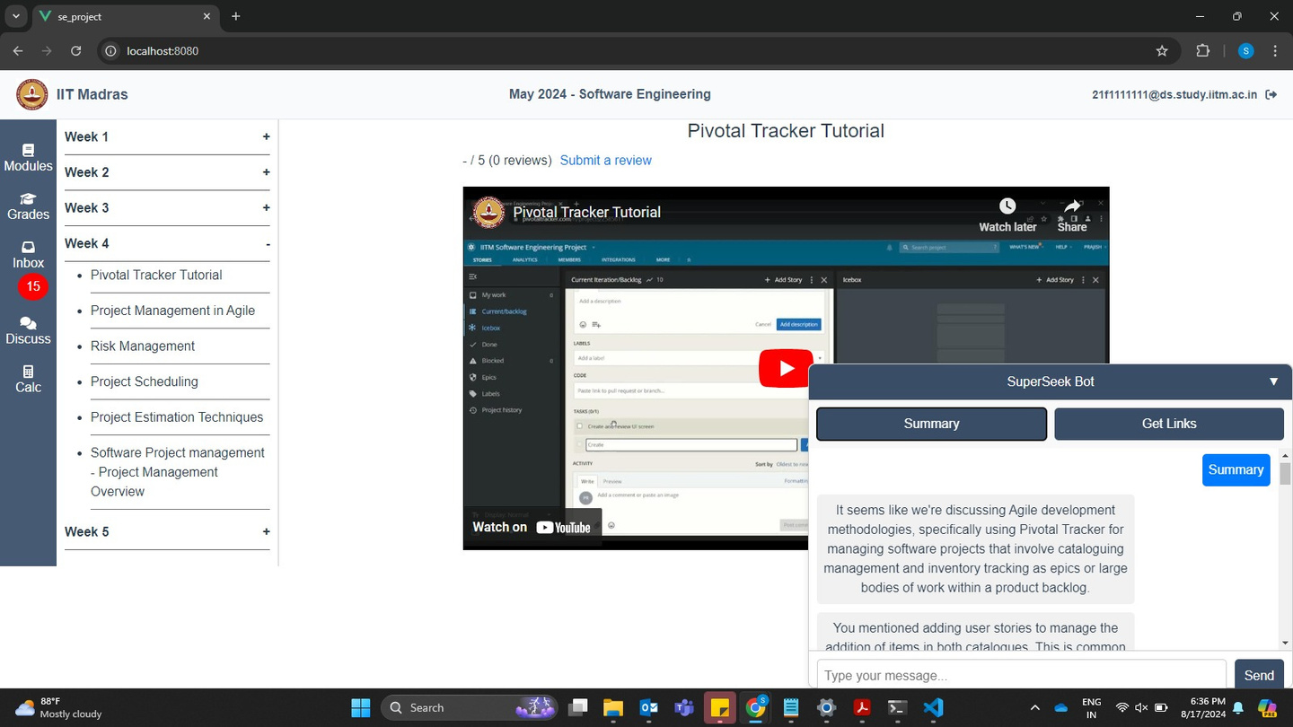
TEAM 30
Actual Output
Summary generation
The lecture transcript is provided to the Phi3 model from Ollama, which processes the text to generate a concise summary. By analyzing the key points and essential information within the transcript, the Phi3 model creates a summarized version that captures the main ideas, making it easier and quicker to review the lecture content. This approach is particularly useful for students who need to streamline their study sessions by focusing on the most critical aspects of the lecture without sifting through the entire transcript.

Slide 13
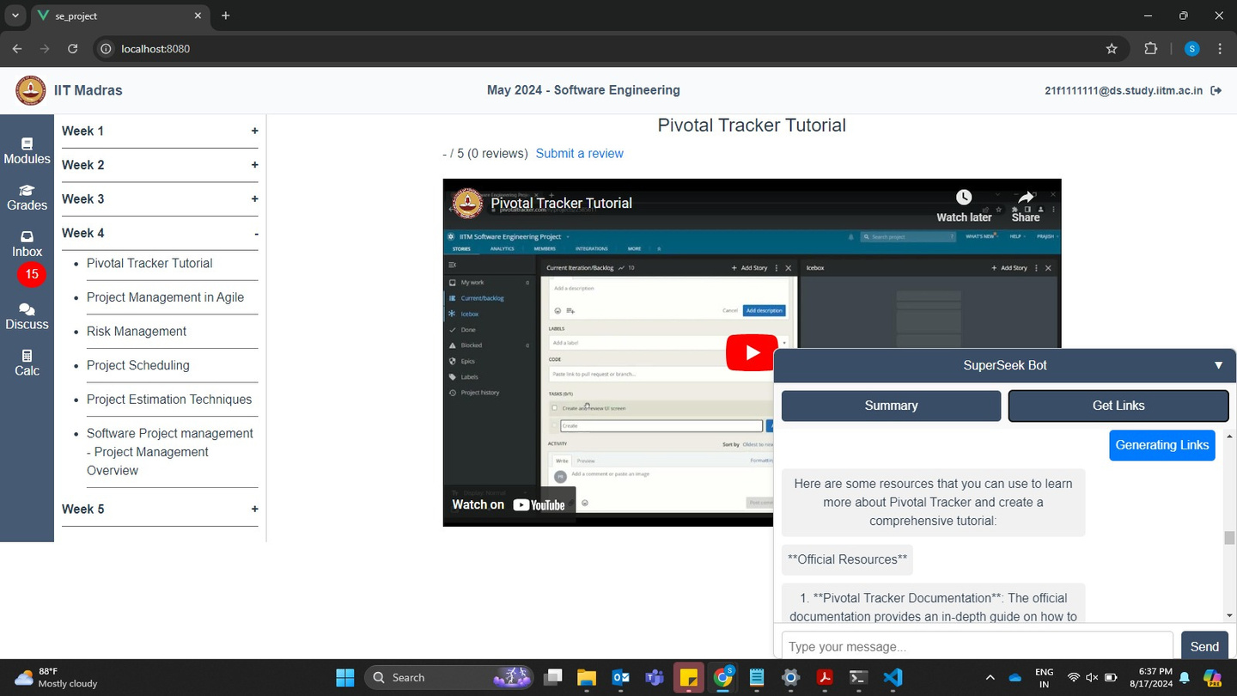
TEAM 30
Actual Output
Getting External Links
To generate external resource links, the title of the topic is sent to the Llama3 model from Ollama. The model processes the title and returns relevant links to external resources that can help deepen understanding of the topic. This allows users to quickly access additional materials, such as articles, videos, or research papers, without having to manually search for them. By using the Llama3 model, the process of finding the right supplementary information is streamlined, making study sessions more efficient and focused.

Slide 14
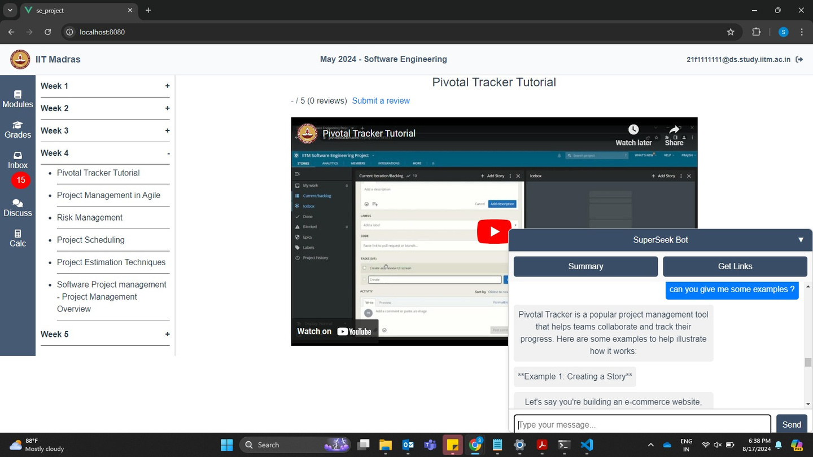
TEAM 30
Actual Output
Custom Chat Prompts
For custom prompts, the query typed in the search box is sent to the Llama3 model from Ollama. The model processes the query and generates a relevant response, providing information or answers tailored to the user's specific question. This feature allows users to obtain quick and accurate answers without needing to leave the study environment, making it easier to stay focused and engaged. By leveraging the Llama3 model, the process of getting precise information is made more efficient, enhancing the overall learning experience.

Slide 15





TEAM 30
Thank You For Your Attention!
Team 30 extends our heartfelt thanks to everyone for patiently listening to our presentation, and to the instructors for teaching us so effectively, enabling us to give our best in this project.
SDLC DOC
DEMO VIDEO
Sdlc.doc.link
demo.video.link
GITHUB REPO
SETUP GUIDE
github.repo.link
readme.md.link

